Slide 1

Hugh’s Organic Loyalty and Promotion Analysis
Presented by: Oluwaseyi Omolewa
Date: 15, January 2025

Slide 2
Executive Summary
This report analyzes Hugh's Organics' loyalty campaign performance and the effectiveness of a promotional event conducted in the Berlin store (E01). The objectives were to determine the loyalty program's impact and assess whether the promotion should be repeated or adjusted. Insights and recommendations are provided to improve future strategies.

Slide 3
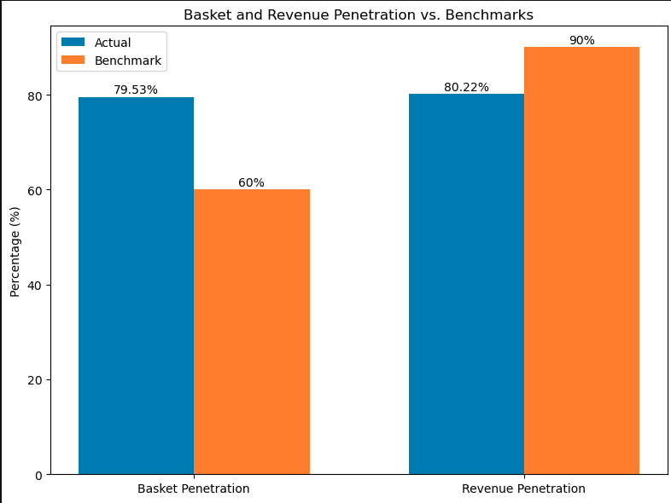
Loyalty Program Analysis Overview
Key Metrics and Observations (2007)
Basket Penetration: 79.53% (Benchmark: 60%).
Revenue Penetration: 80.22% (Benchmark: 90%).
Total Loyalty Customers: 4,192.
Total Points Issued: 24,211 points (including 10% bonus).
Total Points Redeemed: 150,000 points.

Slide 4
Recommendation
Insights and Observation
Basket Penetration (79.53%) vs. Benchmark (60%):
Above the benchmark: The loyalty program seems to be performing well in terms of basket penetration. This indicates strong customer adoption and engagement, as loyalty members generated a significant proportion of total transactions.
Revenue Penetration (80.22%) vs. Benchmark (90%):
Below the benchmark: While revenue penetration is fairly high, it falls short of the benchmark by 9.78%. This suggests that, although loyalty members contribute significantly to transactions, it looks like the average spend per transaction is lower compared to the industry benchmark.
To increase revenue penetration, I’ll recommend the following strategies to boost the average spend per loyalty member:
Introduce targeted promotions, such as double points for purchases above a certain amount.
Use the cust_lifestage data to offer personalized discounts or product bundles tailored to specific customer groups.
Highlight premium products to loyalty members, incentivizing and encouraging higher spending.

Slide 5
Issuance VS Redemption
Total points earned (Issued): 24,211 points.
Total loyalty customers who earned points: 4,192
Total Points Redeemed: 150,000 points.
Customers who redeemed: 1,500
Average Points Earned vs Redeemed per Customer:
Average Points Earned per Customer: 24,211/4,192 = 5.78 points
Average Points Redeemed per Customer: 150,000/1,500 = 100 points
The large gap suggest that customers who redeemed likely accumulated points over years
Observations and Recommendations
There is no time limit on when points earned in a financial year can be redeemed, which causes carry-over points that might create a deficit in the FY budget. To curb this, I’d recommend time-based redemption.
It looks like the majority of loyalty members are not reaching redemption thresholds (we need the redemption data to verify this). This could potentially lead to frustration and customer churn. To mitigate this, I’d recommend reducing the redemption threshold.
The high redemption shows that a core group of customers value the program and find value in earning and using points. I’d recommend promoting the loyalty program more.

Slide 6
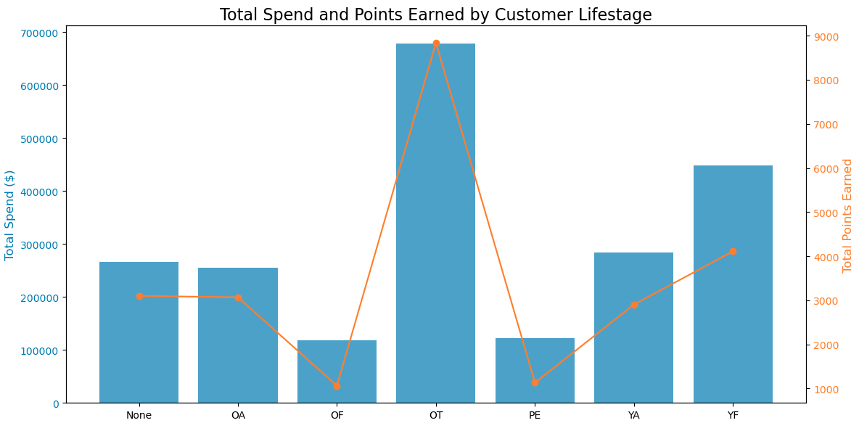
Customer Segmentation Analysis
CUST_LIFESTAGE | Number of Loyalty Customers | Total Points Earned | Total Spend ($) | Average Spend per Customer ($)
Other | 1,720 | 8,839.6 | 677,986.92 | 394.18
Young Family | 518 | 4,110.7 | 447,500.70 | 863.90
None (unclassified) | 448 | 3,098.7 | 266,424.52 | 594.70
Older Adult | 475 | 3,067.9 | 254,682.92 | 536.17
Young Adult | 567 | 2,902.9 | 283,204.19 | 499.48
Pensioners | 310 | 1,129.7 | 122,765.01 | 396.02
Older Family | 154 | 1,061.5 | 117,856.59 | 765.30

Slide 7
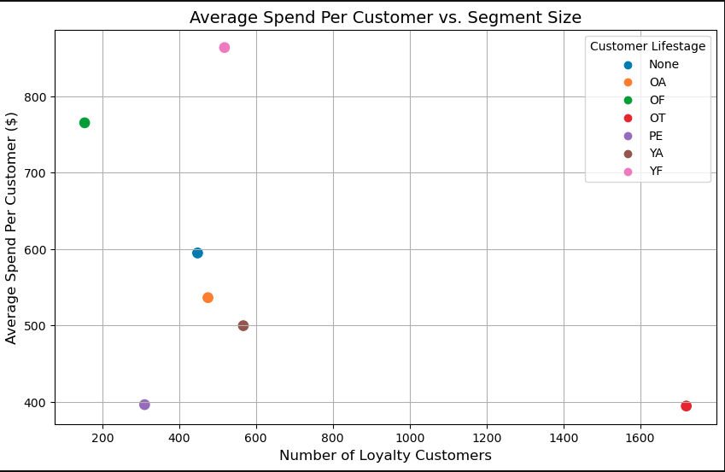
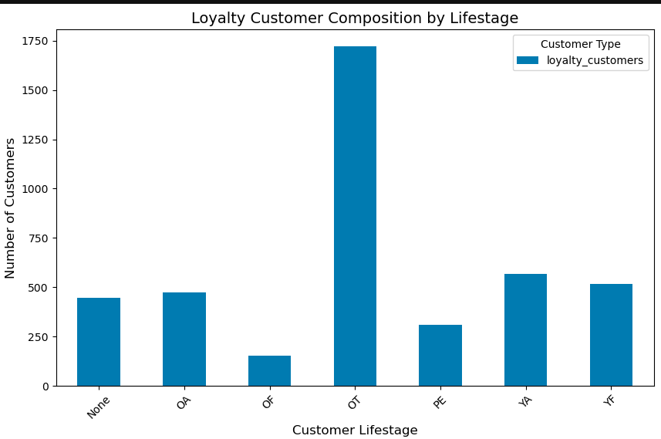
Segment-Specific Recommendation:
Run targeted campaigns to acquire more customers in high-value segments (e.g., Young Families).
Analyze the “Other” segment to uncover subgroups. What makes up this group?
Audit stores to know if they have products that relate to the PE and OF demography and if they are easily accessible.

Slide 8
Berlin Store E01 Promotional Analysis
Promotion Details:
Objective: Drive transactions through a prize draw.
Cost: $5,000.
Control Store: Budapest (E03).

Slide 9
Pre-promotional VS Promotional Analysis
Metric | E01 Pre-promo (May) | E01 promo(June) | E03 Pre-Promo(May) | E03 Promo(June) | Change (E01) | Change (E03)
Revenue | 16,515.94 | 18,839.72 | 15,717.20 | 16,496.41 | +2,323.78 (14.06%) | +779.21 (4.96%)
Transactions | 1,405 | 3,173 | 1,300 | 1,314 | +1,768 (125.83%) | +14 (1.08%)
Average Spend | 1.86 | 1.87 | 1.88 | 1.91 | +0.01 (0.54%) | +0.03 (1.60%)
Loyalty Customers | 357 | 690 | 349 | 353 | +333 (93.28%) | +4 ( 1.15%)
Non-loyalty | 261 | 663 | 268 | 270 | +402 (154%) | +2 ( 0.75%)

Slide 10
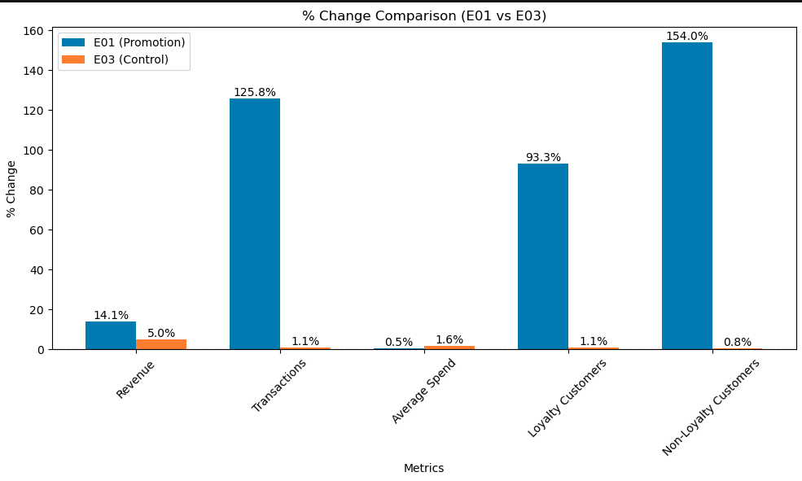
Observations and Insights
Revenue: The promotion drove a slight increase (9.1%) in revenue compared to the baseline
Transactions: The promotion in E01 more than doubled the number of transactions (125.83% increase).
Average spend: Despite the promotion, E03 (control store) outperformed E01 (by 1%), suggesting the promotion in E01 primarily drove more transactions rather than increasing basket size. This might indicate that there is no minimum amount to spend before entering the draw.
Increase in Loyalty and Non-Loyalty Customers: The promotion significantly boosted both loyalty (93.28% increase ) and non-loyalty customer (154% increase) participation in E01). With E03 having no significant change in customer engagement, this indicates the promotion in E01 was effective at re-engaging existing loyalty members and effectively reaching new or casual shoppers.
How the promotion impacted E01 compared to the baseline growth in E03.

Slide 11
Calculating the Promotion Impact
Subtracting the baseline growth in the control store (E03) from the incremental revenue to get the promotional impact:
Promotion Impact (E01) = Incremental Revenue (E01) − Incremental Revenue Promotion Impact (E03)
2,323.78 − 779.21 = 1,544.57
Calculating the ROI:
ROI = Promotion Impact / Promo Cost×100
ROI = 1,544.57/5,000 * 100
ROI = 30.89%
Looking at the promotion in the short term, it seems like an unprofitable investment; however, looking at the bigger picture, it is important to look at the post-promotion data to analyze how the newly acquired and engaged customers contribute to the store’s growth. Future purchases and transactions may be attributed to this promotion.

Slide 12
Insights and Observation
What Worked
What Didn’t Work
The promotion drove significant increases in:
Transactions: More than doubled compared to pre-promotion.
Customer acquisition and engagement: Attracted and engaged both loyalty and non-loyalty customers.
The average spend per transaction ($1.87) barely changed, suggesting the promotion incentivized more purchases but not higher-value purchases.
A 9% impact in revenue seems small for a promo that had a 124% impact on transactions.

Slide 13
Recommendations on how to improve
1. Rerun promotion with minimum-spend condition:
By encouraging customers to spend more to qualify, the store can increase the basket size and maximize revenue while still driving engagement. For example, setting the minimum spend threshold just above the average spend (eg at $2.80) encourages customers to spend more without setting the bar too high and discouraging participation. Monitor and adjust the threshold in future promotions based on customer response.
2. Encourage non-loyalty customers to join the loyalty program:
While non-loyalty customers increased more, the store should focus on converting these customers into loyalty members with signup incentives. Combine the minimum spend with loyalty program incentives (e.g., "Earn double points if you're a loyalty member and spend $5 or more"). 3. Focus on Higher Spend and consider optimizing promo costs: Offer promotions that encourage larger basket sizes, such as discounts for spending above a threshold while shifting to more cost-effective advertising to improve ROI.
4. Target specific customer groups: Use customer segmentation (e.g. customer lifestage column) to target promotions more effectively. For example, focus on loyal customers with higher average spend or customers who haven’t shopped recently.
5. Need for more data (CAC and CLV): Understanding data like the CLV and CAC allows the store to assess the long-term profitability of the customers acquired or engaged through the promotion. This can help to estimate the value of customers acquired during the promotion

Slide 14
Key Takeaways
Loyalty Program:
Optimize the loyalty program to increase the average spend per customer to improve the revenue penetration
Ensure the financial sustainability of the program.
Store E01 Promotion:
Rerun promo and test with different minimum spend amounts
Understand the CAC and CLV to get the bigger picture of the promotion

Slide 15
Thank You

